Slide 1
Criminal Justice Systems and Processes
Provided by D. Frank Davis, M.Ed., AAAC, CCJP, LCDC
Adjunct Faculty San Antonio College

Slide 2
Objectives
Define “What the Criminal Justice System” is
Define the relationship between addiction on its affects on the criminal justice system
Define diversion programs such as drug courts

Slide 3
Video
Addiction and the Justice System: Deciphering the Maze
http://media.recoverymonth.gov/asf1/3CSAT/R2R-06/06-0705Justiceshow.wmv

Slide 4
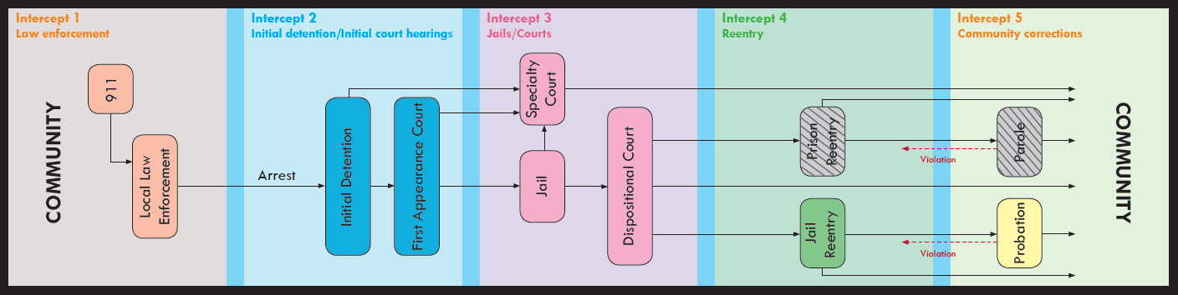
Sequential Intercept Model of the Criminal Justice System
Joplin, L., 2014

Slide 5
The Criminal Justice System
What is it?
The criminal justice system is the set of agencies and processes established by governments to control crime and impose penalties on those who violate laws.
There is no single criminal justice system in the United States but rather many similar, individual systems.
How the criminal justice system works in each area depends on the jurisdiction that is in charge: city, county, state, federal or tribal government or military installation.
  Different jurisdictions have different laws, agencies, and ways of managing criminal justice processes.

Slide 6
The main systems are:
State: State criminal justice systems handle crimes committed within their state boundaries.
Federal: The federal criminal justice system handles crimes committed on federal property or in more than one state.

Slide 7
System Components
Most criminal justice systems have five components-law enforcement, prosecution, defense attorneys, courts, and corrections, each playing a key role in the criminal justice process.

Slide 8
Law Enforcement
Law enforcement officers take reports for crimes that happen in their areas.
Officers investigate crimes and gather and protect evidence.
Law enforcement officers may arrest offenders, give testimony during the court process, and conduct follow-up investigations if needed.

Slide 9
Prosecution
Prosecutors are lawyers who represent the state or federal government (not the victim) throughout the court process-from the first appearance of the accused in court until the accused is acquitted or sentenced.
Prosecutors review the evidence brought to them by law enforcement to decide whether to file charges or drop the case.
Prosecutors present evidence in court, question witnesses, and decide (at any point after charges have been filed) whether to negotiate plea bargains with defendants.

Slide 10
Prosecution
They have great discretion, or freedom, to make choices about how to prosecute the case.
Victims may contact the prosecutor's office to find out which prosecutor is in charge of their case, to inform the prosecutor if the defense attorney has contacted the victim, and to seek other information about the case.

Slide 11
Defense Attorneys
Defense attorneys defend the accused against the government's case.
They are ether hired by the defendant or (for defendants who cannot afford an attorney) they are assigned by the court. (Most drug offenders)
While the prosecutor represents the state, the defense attorney represents the defendant.

Slide 12
Courts
Courts are run by judges, whose role is to make sure the law is followed and oversee what happens in court.
They decide whether to release offenders before the trial.
Judges accept or reject plea agreements, oversee trials, and sentence convicted offenders.

Slide 13
Corrections
Correction officers supervise convicted offenders when they are in jail, in prison, or in the community on probation or parole.
In some communities, corrections officers prepare pre-sentencing reports with extensive background information about the offender to help judges decide sentences.
The job of corrections officers is to make sure the facilities that hold offenders are secure and safe.

Slide 14
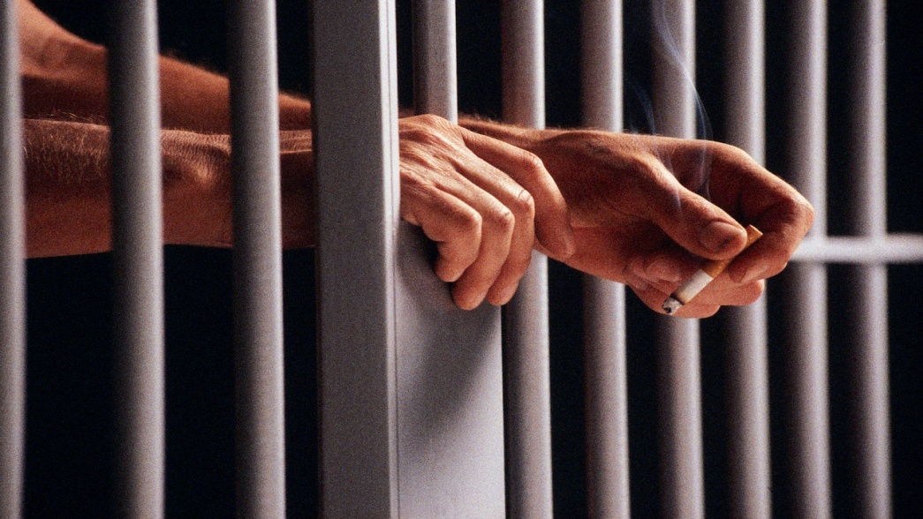
Corrections
They oversee the day-to-day custody of inmates.
They also oversee the release processes for inmates and sometimes notify victims of changes in the offender's status.

Slide 15
How the Criminal Justice Process Works
The process may vary according to the jurisdiction, the seriousness of the crime (felony or misdemeanor),
  Felonies are punishable by more than one year in prison
  Misdemeanors are punishable by up to one year in jail.
Whether the accused is a juvenile or an adult
Not every case will include all these steps, and not all cases directly follow this sequence.
    Many crimes are never prosecuted because they are not reported, because no suspects can be identified, or because the available evidence is not adequate for the prosecutor to build a case.

Slide 16
Entry into the System
Report
  Law enforcement officers receive the crime report from victims, witnesses, or other parties (or witness the crime themselves and make a report).
Investigation
  Law enforcement investigates the crime.
  Officers try to identify a suspect and find enough evidence to arrest the suspect they think may be responsible.

Slide 17
Entry into the System
Arrest or Citation
  If they find a suspect and enough evidence, officers may arrest the suspect or issue a citation for the suspect to appear in court at a specific time.
  This decision depends on the nature of the crime and other factors.
  If officers do not find a suspect and enough evidence, the case remains open.

Slide 18
Prosecution and Pretrial
Charges
  The prosecutor considers the evidence assembled by the police and decides whether to file written charges (or a complaint) or release the accused without prosecution.
First Court Appearance
  If the prosecutor decides to file formal charges, the accused will appear in court to be informed of the charges and of his or her rights.
  The judge decides whether there is enough evidence to hold the accused or release him or her.

Slide 19
Prosecution and Pretrial
  If the defendant does not have an attorney, the court may appoint one or begin the process of assigning a public defender to represent the defendant.
Bail or Bond
  At the first court appearance (or at any other point in the process-depending on the jurisdiction) the judge may decide to hold the accused in jail or release him or her on bail, bond, or on his or her"own Recognizance" (OR)," (OR means the defendant promises to return to court for any required proceedings and the judge does not impose bail because the defendant appears not to be a flight risk).

Slide 20
Prosecution and Pretrial
  To be released on bail, defendants have to hand over cash or other valuables (such as property deeds) to the court as security to guarantee that the defendant will appear at the trial.
  Defendants may pay bail with cash or bond (an amount put up by a bail bondsman who collects a non-refundable fee from the defendant to pay the bail).
  The judge will also consider such factors as drug use, residence, employment, and family ties in deciding whether to hold or release the defendant.

Slide 21
Prosecution and Pretrial
Grand Jury or Preliminary Hearing
  In about one-half of the states, defendants have the right to have their cases heard by a grand jury, which means that a jury of citizens must hear the evidence presented by the prosecutor and decide whether there is enough evidence to indict the accused of the crime.
  If the grand jury decides there is enough evidence, the grand jury submits to the court an indictment, or written statement of the facts of the offense charged against the accused.

Slide 22
Prosecution and Pretrial
  In other cases, the accused may have to appear at a preliminary hearing in court, where the judge may hear evidence and the defendant is formally indicted or released.

Slide 23
Prosecution and Pretrial
Arraignment
  The defendant is brought before the judge to be informed of the charges and his or her rights.
  The defendant pleads guilty, not guilty, or no contest (accepts the penalty without admitting guilt).

Slide 24
Prosecution and Pretrial
  If the defendant pleads guilty or no contest, no trial is held, and offender is sentenced then or later.
  If the defendant pleads not guilty, a date is set for the trial. If a plea agreement is negotiated, no trial is held.

Slide 25
Adjudication (Trial Process)
Plea Agreements
  The majority of cases are resolved by plea agreements rather than trials.
  A plea agreement means that the defendant has agreed to plead guilty to one or more of the charges in exchange for one of the following:

Slide 26
Adjudication (Trial Process)
    A plea agreement means that the defendant has agreed to plead guilty to one or more of the charges in exchange for one of the following:
      dismissal of one or more changes,
      a lesser degree of the charged offense,
      a recommendation for a lenient sentence,
      not recommending the maximum sentence, or making no recommendation.
    The law does not require prosecutors to inform victims about plea agreements or seek their approval.

Slide 27
Adjudication (Trial Process)
Trial
  Trials are held before a judge (bench trial) or judge and jury (jury trial), depending on the seriousness of the crime and other factors.
  The prosecutor and defense attorney present evidence and question witnesses.
  The judge or jury finds the defendant guilty or not guilty on the original charges or lesser charges.

Slide 28
Adjudication (Trial Process)
  Defendants found not guilty are usually released.
  If the verdict is guilty, the judge will set a date for sentencing.

Slide 29
Post-Trial
Sentencing
  Victims are allowed to prepare for the judge (and perhaps to read at the sentencing hearing) a victim impact statement that explains how the crime affected them.
  In deciding on a sentence, the judge has a range of choices, depending on the crime.

Slide 30
Post-Trial
  These choices include restitution (paying the victim for costs related to the crime), fines (paid to the court), probation, jail or prison, or the death penalty.
  In some cases, the defendant appeals the case, seeking either a new trial or to overturn or change the sentence.

Slide 31
Post-Trial
  Probation or Parole
    A judge may suspend a jail or prison sentence and instead place the offender on probation, usually under supervision in the community.
    Offenders who have served part of their sentences in jail or prison may-under certain conditions-be released on parole, under the supervision of the corrections system or the court.
    Offenders who violate the conditions of their probation or parole can be sent to jail or prison.

Slide 32
If You Are a Victim
The criminal justice system can be overwhelming, intimidating, and confusing for anyone who does not work within it every day. As a victim, you will need to know what to expect and have support throughout the process.
You will also want to know your rights and the choices you may have to make.⁴ You may also need information and guidance to help you stay safe. For example, if you are harassed or stalked by the offender at any point in the criminal justice process, you should immediately report these violations to the police and inform the prosecutor. Also, while the offender is in jail or prison, the corrections staff is generally required to notify you if the offender is released or escapes or if a parole hearing is pending, if you request such notification. Also, most states have automated notification systems that allow registered victims (those who sign up) to check on the status of an offender at any time. Such systems will automatically notify you of an inmate's escape or release. (See www.vinelink.com/vinelink/initMap.do for more information about state notification systems.)

Slide 33
1. Readers may find it helpful to consult their local victim assistance program, local prosecutor's office, state attorney general's office, local or state bar association, or local law library for information specific to their own area or jurisdictions.
2. Defense attorneys sometimes contact victims about their case. Victims do not have to talk to defense attorneys or their investigators and are encouraged to contact the prosecutor if they have any concerns about such requests.
3. Felonies are punishable by more than one year in prison; misdemeanors are punishable by up to one year in jail.
4. See www.victimlaw.org for general information about victims' rights.
All rights reserved.
Copyright © 2008 by the National Center for Victims of Crime. This information may be freely distributed, provided that it is distributed free of charge, reprinted in its entirety, and includes this copyright notice.

Slide 34
Systems and Process
There are many types of arrest and points along they way where counselors can work with this designated population.
Just because someone is involved in the Justice System doesn’t mean they don’t have the right or the need for substance abuse or mental health treatment.

Slide 35
Screening and Assessment
Very important when considering placement or level of care.
Screen out offenders who do not need treatment
Assess the extent of treatment needs to make appropriate referrals.
Ensure offenders receive the treatment they need, rather than being released into the community with high probability of re-offending
                TIP 44

Slide 36
Correctional Settings
Screening and assessment equated with eligibility and suitability
Eligibility is determined in pretrial and jail settings by screening for offenders who may need treatment.
Suitability is determine placement into different levels of treatment.
  Identify key psychosocial problems
  Supervision level

Slide 37
Eligibility and Suitability
Eligibility
  Does the offender meet the system’s criteria for receiving treatment services.
  Screen to determine if person warrants assessment to determine if person has alcohol or drug problem.
Suitability
  Determine if offender is suitable for type of program services available.
  Assess to determine whether capable of benefiting form treatment or other intervention
  Suitability is considered after determining eligible

Slide 38
Considerations for
Placement of Offenders
Recidivism risk
Level of needs for substance abuse, mental health and other psychosocial or medical services, and employment
Motivation and readiness for treatment
Offender characteristics
  Cognitive and intellectual abilities
  Education, reading and writing level
  Ability to communicate in individual and group setting
  Ability to handle stress in intensive TCs.

Slide 39
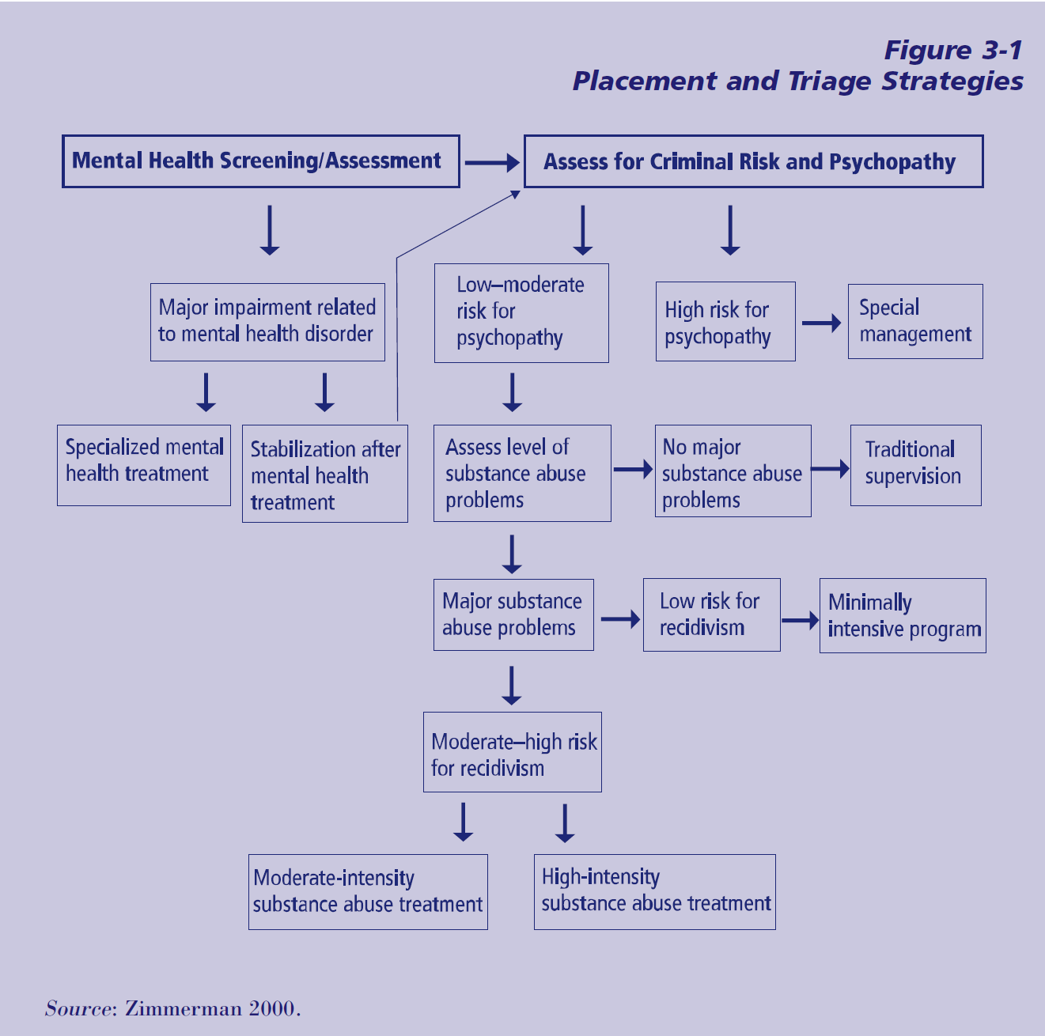

Slide 40
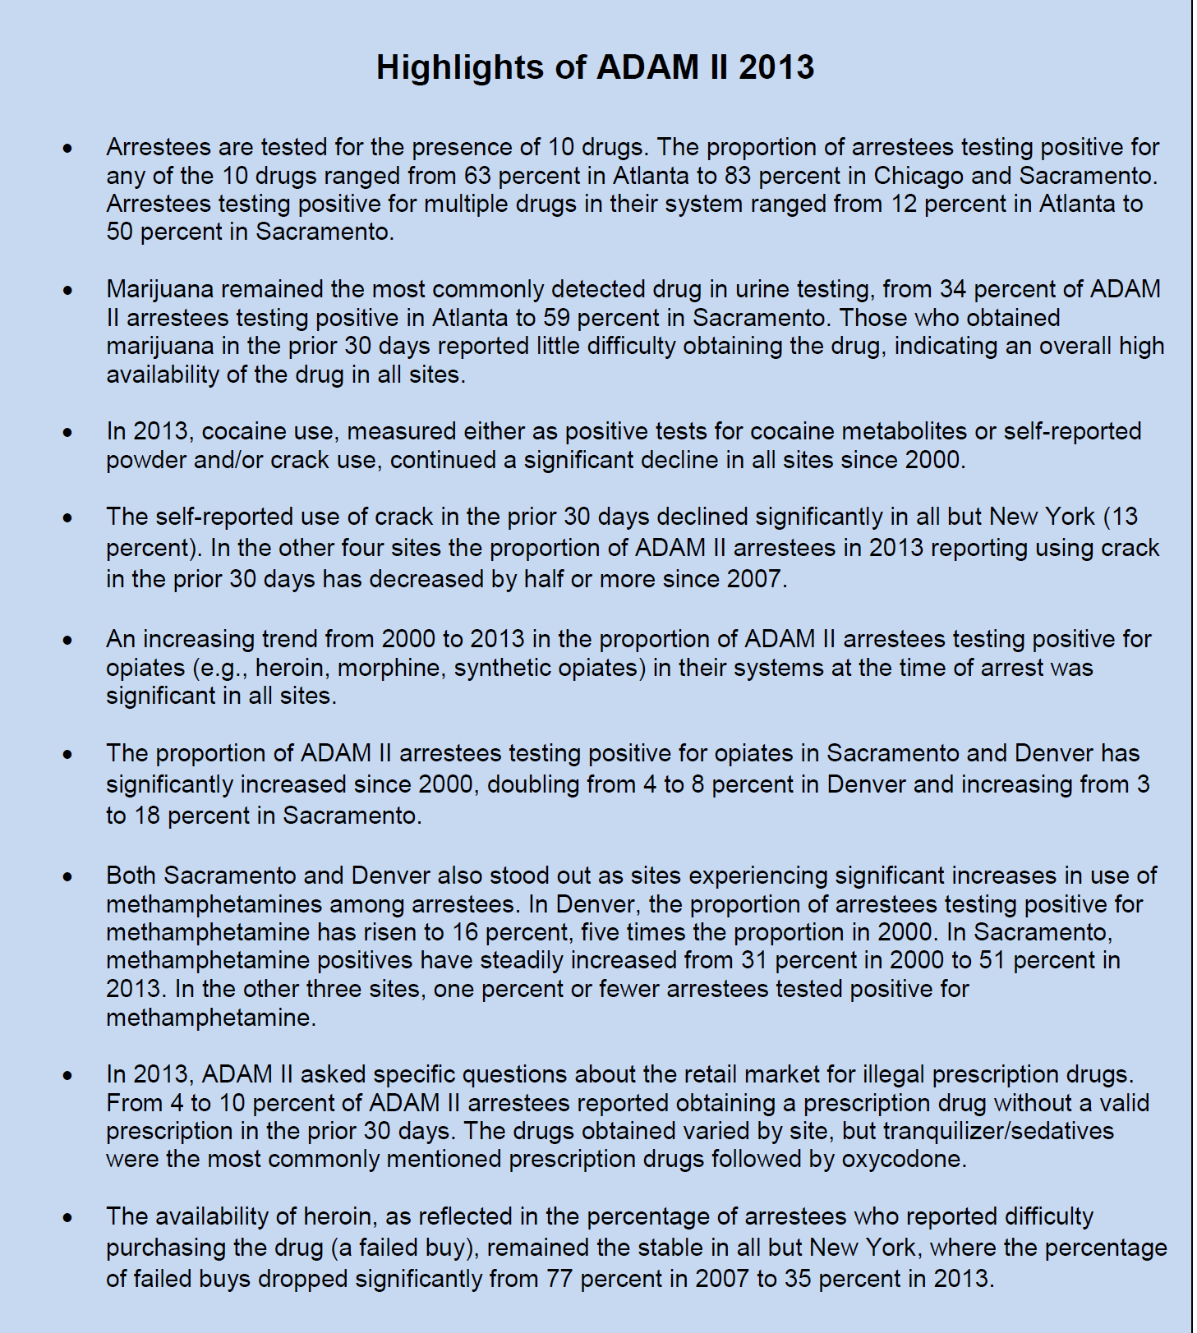
Characteristics of the Population

Slide 41
Treatment Services in Pre-Trial Justice Systems
Arrest
  Option to divert to sobering centers and treatment depending on charge, instead of arresting
  May be window of opportunity to get some into treatment

Slide 42
Important Considerations
Treatment should not compromise the due process rights of defendants.
Treatment professionals should bear in mind the presumption of innocence that exists during pretrial
Defendants’ due process rights are of vital interest and affect what they are willing to agree to and the type of information they are willing to disclose.
Defendants should not be coerced into waiving due process rights.
                TIP 44

Slide 43
Arraignment
  Can be referred to treatment services during this stage of process.
  May be allowed to attend treatment of be under electronic monitoring.

Slide 44
Pretrial Diversion
Supervision in lieu of detention
  Condition of release is to participate in treatment.
  Monitor by pretrial supervision or probation department to monitor compliance.
  Failure to comply results in return to jail and await trial.
  Completion of treatment or other conditions can mitigate the sentence if convicted.

Slide 45
Pretrial Diversion
Treatment in lieu of prosecution
  Charges dropped if person completes treatment
  Usually has to be agreed by prosecutor.
  If defendant fails to complete treatment and comply with other conditions, may risk being sentenced more harshly.
  Defendant is still considered innocent.

Slide 46
Plea Bargaining
Requirement that the defendant enter treatment can be part of the plea.
Often offered as an option to avoid lengthy prison sentence.

Slide 47
Information Management During the Pretrial Stage
Key to identifying treatment needs and can provide treatment and related services
Complexity can cause difficulty in access the information on timely basis

Slide 48
Information Management During the Pretrial Stage
Pretrial information:
  Criminal record
  Prior compliance with supervision
  Pretrial evaluation
  Substance abuse assessment information
  Mental health treatment
  Relevant medical infomration

Slide 49
Diversion to Treatment
Drug Treatment Courts most popular and provides safeguards so prosecutors can reinstate charges for unsuccessful termination
Multisystem collaboration between criminal justice agencies, treatment providers, and community resources

Slide 50
Drug Treatment Courts
Changing the way criminal justice system deals with offenders who use drugs or alcohol
Many different types of drug courts
Effective in engaging and retaining offenders in treatment
Reduce criminal recidivism

Slide 51
United States Drug Courts
* 2,838 Drug Courts in Operation in the United States and its Territories as of June 30, 2013
Court type | Number
Adult (*442 of which are hybrid DWI/Drug Courts) | 1,485
Juvenile | 447
Family Treatment | 311
Tribal Healing to Wellness | 119
Designated DWI | 229
Campus | 5
Reentry Drug | 31
Federal Drug | 25
Federal Veterans Treatment | 4
Veterans Treatment | 143
Co-occurring Disorder | 39
Source:ndcrc.org

Slide 52
Texas Drug Courts
140 Drug Court Programs
  Adult
  Juvenile
  Family
  Tribal Healing to Wellness
  DWI
  Federal Reentry
  Reentry
  Veterans
  Prostitution

Slide 53
Start Drug Court Harris County
Tri-phase program
Minimum of 12 months
All phases include
  Substance abuse treatment
  Regular court appearance with judicial interaction
  Drug testing
  12 step or other approved support group mtg.

Slide 54
Typical Drug Court Phases
3 to 4 phases
  Orientation, drug education
  Treatment
  Relapse prevention, educational/vocational services
  Aftercare and transition

Slide 55
Cost and Saving
Typical cost is less than $4,000 for the most intensive treatment track of 12-14 months
According to TDCJ, cost of incarceration for a comparable period is between $14,000 and $17,000.
Additional medical cost associated with the delivery of drug exposed babies are estimated to range between $1,500 to $25,000 per day.
                Harris County Update 5th Annual Community Drug Awareness Day July 6, 2014

Slide 56
10 Key Components of Drug Courts
Integrate alcohol and drug treatment with justice system processing
Use non-adversarial approach, prosecution and defense promote public safety while protecting participants’ due process rights
Eligible participants are identified early and promptly placed in DCP
Provide access to a continuum of alcohol, drug and related treatment and rehab services
Abstinence is monitored by frequent alcohol and illicit drug testing
Coordinated strategy governs drug court responses to participants’ compliance
Ongoing judicial interaction with each drug court participant is essential
Monitoring and evaluating achievement of program goals is necessary to gauge effectiveness
Continuing interdisciplinary education promotes effective drug court planning, implementation and operations
Forging partnerships among courts, public agencies, and community-based organizations

Slide 57
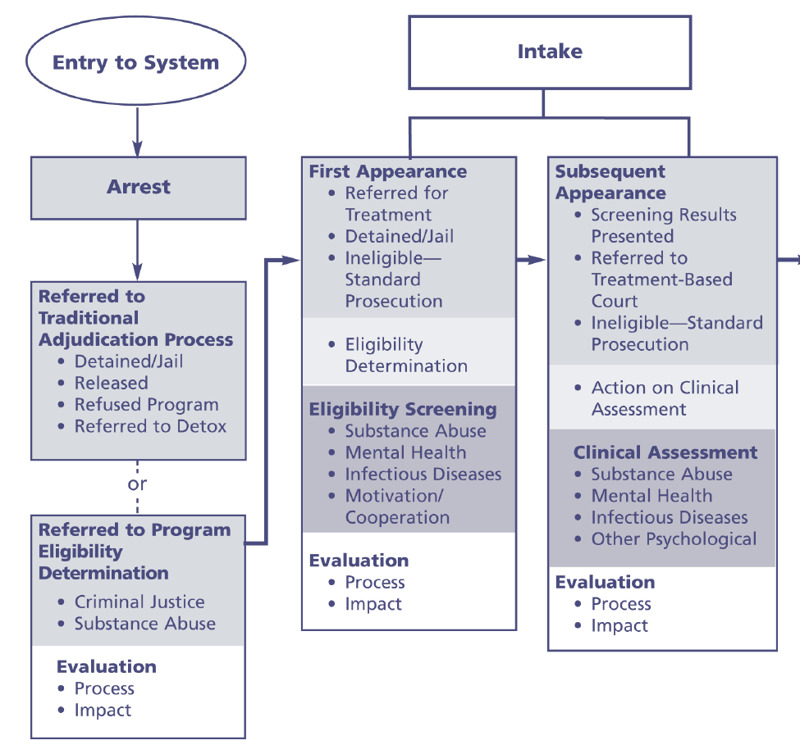

Slide 58
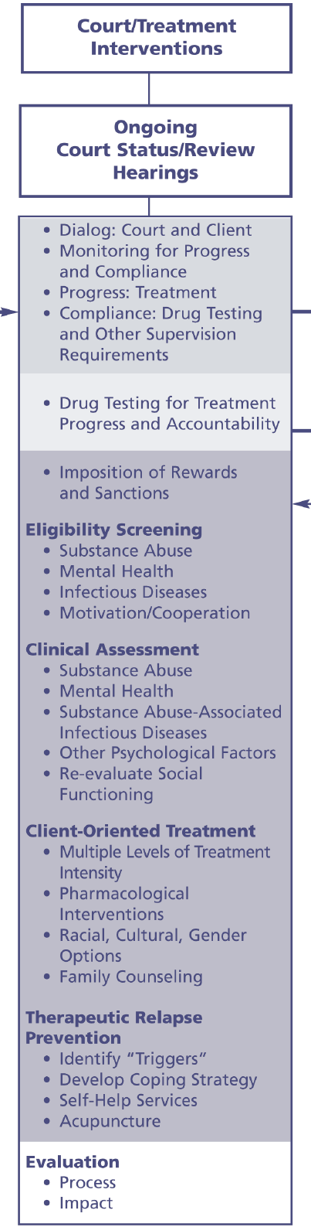

Slide 59
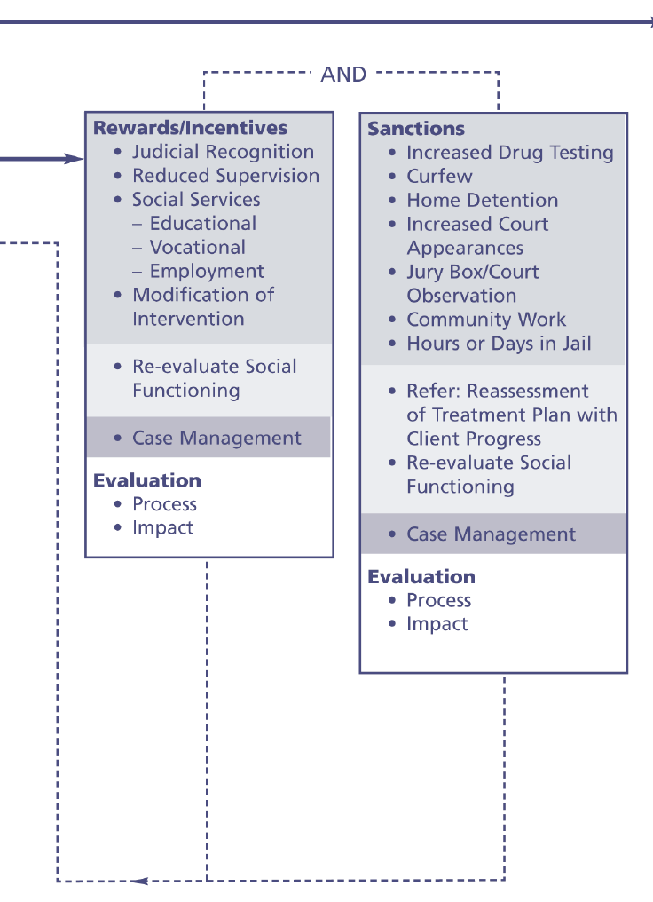

Slide 60
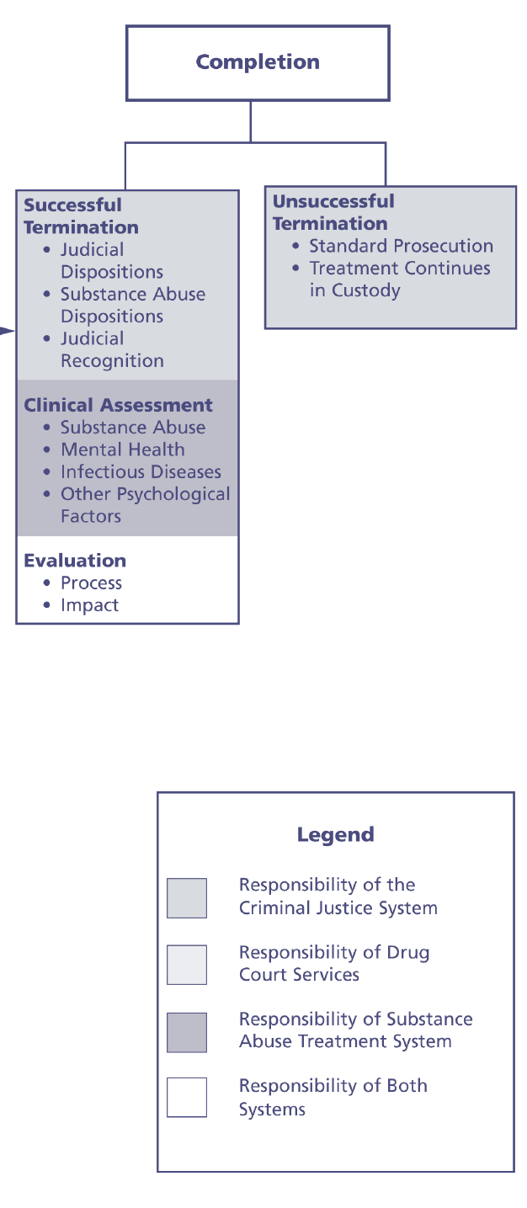

Slide 61
Edward Latessa
Correctional Programs and Evidences Based Practices
https://www.youtube.com/watch?v=8dz36WOmg-8

Slide 62
Edward Latessa, PhD
Solutions in Corrections
https://www.youtube.com/watch?v=GJip3q3apa0&list=PLpIlUxHJ-xbqQaC5Ve5-HmVY6VwElsw9S&index=7

Slide 63
Institutionalization
And Its Effect on
Rehabilitation Efforts

Slide 64
What is “Institutionalization”?
The process by which individuals are shaped and transformed by the institutional environment in which they live
This involves incorporating the norms (both formal and informal) of the environment into one’s habits of thinking, feeling and acting

Slide 65
Institutionalization
This results in the creation of thinking patterns and behaviors which, if continued after release, can be seen as dysfunctional or anti-social

Slide 66
Institutionalization
Offenders do not “choose” to allow this process to take place
Few are even aware that it has occurred
Everyone is affected to some degree, but not in the same way

Slide 67
Institutionalization
History
  1939 – Myerson – “prison stupor” or “prison psychosis” to described the psychological retreat experienced as a result of incarceration
  1948 – Nettlehiem and Sylvester – “psychological institutionalism”. They considered this a “deficiency disease in an emotional sense”

Slide 68
History
1955, Martin began seeing the term “institutionalization” in clinical notes of mental hospitals as an assessment of a patient’s adjustment to the hospital setting – implying the cessation of rebellious acts against his placement
This type of entry indicates that, not only are staff aware that this occurs, but that it is a desired trait

Slide 69
History
1959, Barton identified several contributing factors
  Loss of contact with outside world
  Enforced idleness
    Loss of individualism
    Menial jobs with little or no opportunity for self-expression
  Loss of personal friends, possessions
  Presence of authoritarian staff and an institutional (ward) atmosphere
  Loss of prospects outside of the institution

Slide 70
The Effect on Developing
Treatment Relationships
Hypervigilance, Distrust and Suspicion
Dependence on Institutional Structure
Emotional Over-control, Alienation, Psychological Distancing
Social Withdrawal
Incorporation of Exploitative Norms of the Prison Culture
Diminished Sense of Self-worth

Slide 71
Hypervigilance, Interpersonal Distrust and Suspicion
Based on the very nature of “prison”, offenders learn quickly to become hypervigilant for signs of threat or personal risk
Researchers believe that unless an offender can convincingly project an image that conveys the potential for violence, he is likely to be dominated and exploited throughout the duration of his sentence
This begins early on in the incarceration progression usually manifesting itself while in jail due to the transient nature of the population and no “set” classification process

Slide 72
Unchecked
Results in an inability to form trusting healthy relationships
Inability to form relationships with own children
Inability to seek out assistance when needed

Slide 73
Effect on Rehabilitative Efforts
In order for the desired therapeutic relationship to develop, this wall of distrust must be confronted and overcome
Doing this is an ongoing process. Staff must remember that they are always on “stage”
Our words must match our actions

Slide 74
Dependence on Institutional Structure and Contingencies
Results in the offender relying heavily on the institutional staff when faced with opportunities to make decisions
  If not addressed prior to release, may be uncomfortable or unable to make decisions after release
May result in an individual being unable to rely on their own internal organization and self-imposed personal limits to guide their actions or to restrain their conduct
  This is of special concern with younger offenders. The structure, clear boundaries, set limits and swift corrective action to those who operate outside of the imposed limits, may cause the individual’s internal controls to atrophy or fail to fully develop

Slide 75
Unchecked
May result in the individual being unable to make healthy choices, resulting in a return to old, familiar, unhealthy behaviors (their “calm”)
Inability to function as an “adult” upon release
  Set schedules for self and family
  Make decisions required for an “adult”

Slide 76
Effect on Rehabilitative Efforts
In a pre-release setting, must begin to place the offender in situations (real or role play) where he / she must be required to make the final decision
  These final decisions should then be examined and processed in order to ensure the offender understands to review all possible outcome prior to making a decision

Slide 77
Emotional Over-control, Alienation, Psychological Distancing
Admissions of vulnerability to others inside this environment may open the person up to exploitation
Offenders struggle to control and suppress their own internal emotional reactions to events around them
Some offenders are forced to become skilled “self-monitors” who calculate the anticipated effects that every aspect their behavior might have.

Slide 78
Emotional Over-control, Alienation, Psychological Distancing
This may result in the development of emotional flatness which becomes chronic and debilitating in social interactions
This then results in the realization that they have created a permanent and unbridgeable distance between themselves and others

Slide 79
Unchecked
Inability to express ones-self appropriately
Inability to identify and respond to the emotions of others
Inability to build nurturing relationship with children

Slide 80
Effect on Rehabilitative Efforts
When possible and safe, offenders should be placed in emotional situations and encouraged to discuss feelings
Encourage offenders to realize that everyone experiences feelings
  Emphasize that emotions are natural and experiencing them does not make them vulnerable

Slide 81
Social Withdrawal
Some offenders find protection by becoming “socially invisible”
They become inconspicuous and disconnected from others
This self-imposed social withdrawal and isolation results in a deep retreat within themselves, a lack of trust in others and an isolated life of quiet desperation

Slide 82
Social Withdrawal
Long-term offenders are especially vulnerable to this form of psychological adaptation
Offenders whose lives have changed dramatically since incarceration may begin to develop a belief system that there is nothing left for them, thus they have nothing to offer others

Slide 83
Unchecked
Unwillingness to take chances or offer input
Inability to form relationships with family or others
Social isolation possibly resulting in further mental decline

Slide 84
Effect on Rehabilitative Efforts
Offenders should be encouraged to engage in pro-social behaviors
Offenders should be encouraged to engage in appropriate conversations with individuals other than offenders

Slide 85
Incorporation of Exploitative Norms of the Prison Culture
Prison culture frowns on any sign of weakness and vulnerability
It discourages the expression of candid emotions or intimacy
To guard against this, offenders often adopt a heightened investment in their reputation for toughness, responding to insignificant insults or physical violations, quickly and decisively

Slide 86
Incorporation of Exploitative Norms of the Prison Culture
In male institutions, this may result in hyper-masculinity where force and domination are glorified as essential components of one’s identity
Men and women, in an environment characterized by enforced powerlessness and deprivation, confront distorted norms of sexuality where dominance and submission become entangled and mistaken for healthy relationships

Slide 87
Unchecked
Embracing these values too fully may create barriers to:
Developing meaningful interpersonal contacts upon release
An unwillingness to trust others
  Seeking help with personal problems
Prone to impulsive overreaction
Inability to form trusting, healthy relationships

Slide 88
Effect on Rehabilitative Efforts
When these behaviors are observed, they should be pointed out (in a non-threatening manner) and corrective action should be discussed

Slide 89
Diminished Sense of
Self-worth
Upon incarceration, offenders lose their right to privacy and control over mundane aspects of life which most citizens take for granted
Personal Space
Lack of Privacy
No choice over who they live with
No freedom to choose

Slide 90
Diminished Sense of
Self-worth
These conditions tend to make individuals feel more like children than adults
They are constant reminders of their compromised social status and stigmatized social role as an offender
In extreme cases, offenders begin to think of themselves as “the kind of person” who deserves this type of treatment

Slide 91
Effect on Rehabilitative Efforts
Staff should encourage the use of positive “self-talk”
Staff should utilize volunteers who have changed their lives after release from incarceration
Staff should identify pro-social behaviors and offer appropriate praise

Slide 92
Implications for the Transition From Prison to Home
Without an understanding of the changes they may have undergone while incarcerated, institutionalization may:
  Interfere with the transition from prison to home
  Impede an ex-offender’s successful reintegration into a social network and employment
  Make overcoming the stigma of “ex-con” more difficult
  Difficulty with a parental relationship

Slide 93
What Can We Do?
Consistent emphasis on visitation, supporting contact with the outside world
Emphasis on creating a “safe” environments to reduce hypervigilance

Slide 94
What Can We Do?
Family / Relationship work
  Stigmas attached to their support system
  Building appropriate, healthy support systems
Communication skills / Interviewing skills
Effective decision making
Increased emphasis on labeling feelings
Emphasis on effective / healthy confrontation
Life Skills

Slide 95
Last Thought
It is of interest to note that staff working in businesses, not just in an institutional environment, may become “institutionalized”
  They rely on the Supervisor to tell them exactly what to do
  They accept the restrictions on self-expression of opinions
  They become incapable of independent thought

Slide 96
To combat this, managers should, to the extent possible
  Build trusting, open relationships
  Create a culture that demands employees offer their own possible solutions to issues
  Reward initiative
  Promote risk
  Applaud dissent
  Guard against Micro-management

Slide 97
References
The Psychological Impact of Incarceration: Implications for Post-Prison Adjustment, C. Harvey 2002
Institutionalization: A Theory of Human Behavior and the Social Environment, M. Johnson and R. Rhodes, 2007
The Vilification of Sex Offenders: Do Laws Targeting Sex Offenders Increase Recidivism and Sexual Violence, H. Wakefield

Slide 98
References
Center for Substance Abuse Treatment. Substance Abuse Treatment for Adults in the Criminal Justice System. Treatment Improvement Protocol (TIP) Series 44. HHS Publication No. (SMA) -4056. Rockville, MD: Substance Abuse and Mental Health Services Administration, 2005.
Joplin, L. (2014, June 1). Mapping the Criminal Justice System to Connect Justice-Involved Individuals with Treatment and Health Care under the Affordable Care Act. Retrieved August 8, 2014, from https://s3.amazonaws.com/static.nicic.gov/Library/028222.pdf
http://www.ndcrc.org/content/how-many-drug-courts-are-there
Office of National Drug Control Policy (2014). 2013 Annual Report, Arrestee Drug Abuse Monitoring Program II. Washington, DC: Executive Office of the President.
The Criminal Justice System. (2008, January 1). Retrieved August 9, 2014.

